Slide 1

1
Rain Watch: A Smart Rain Prediction and Crop Health Insight Platform
Revolutionizing agriculture and urban planning with precise rain forecasts and tailored crop health notifications, empowering farmers and communities for sustainable decisions.

Slide 2

Team and Contact
Alpha Deity: Passionate CSE-AIML students from CBIT driving AI for agriculture.
Badrinath-160123748029
Saiteja-160123748049
Revanth Kumar-160123748051
Pawan Kalyan-160123748060
Sharan Kumar-160123748061
E-Mail ID: revanthkparna@gmail.com

Slide 3
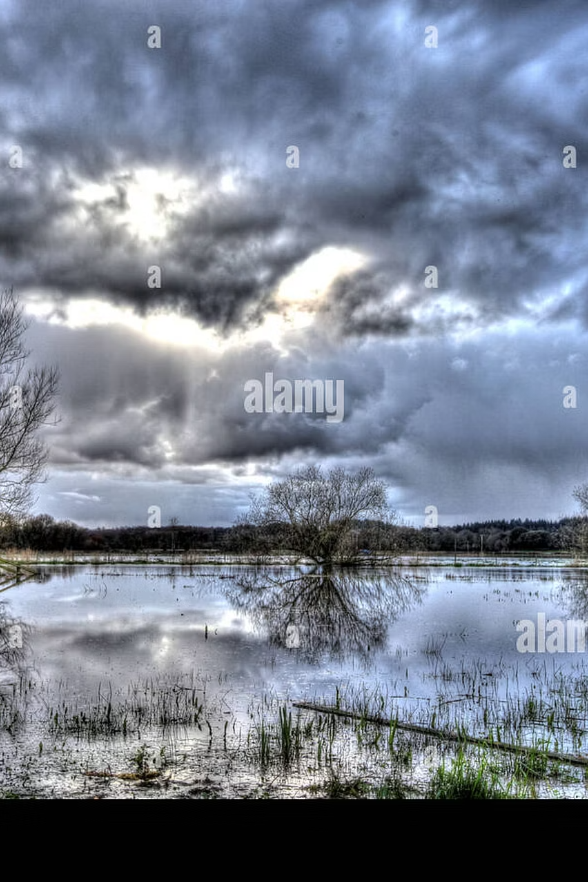
The Rainfall Challenge
Unpredictable weather disrupts farming operations, leading to crop losses estimated at $10B annually in the US. Urban areas face flooding risks, while farmers lack real-time insights on how rain impacts specific crops like corn or wheat, hindering yield optimization and resource allocation.

Slide 4
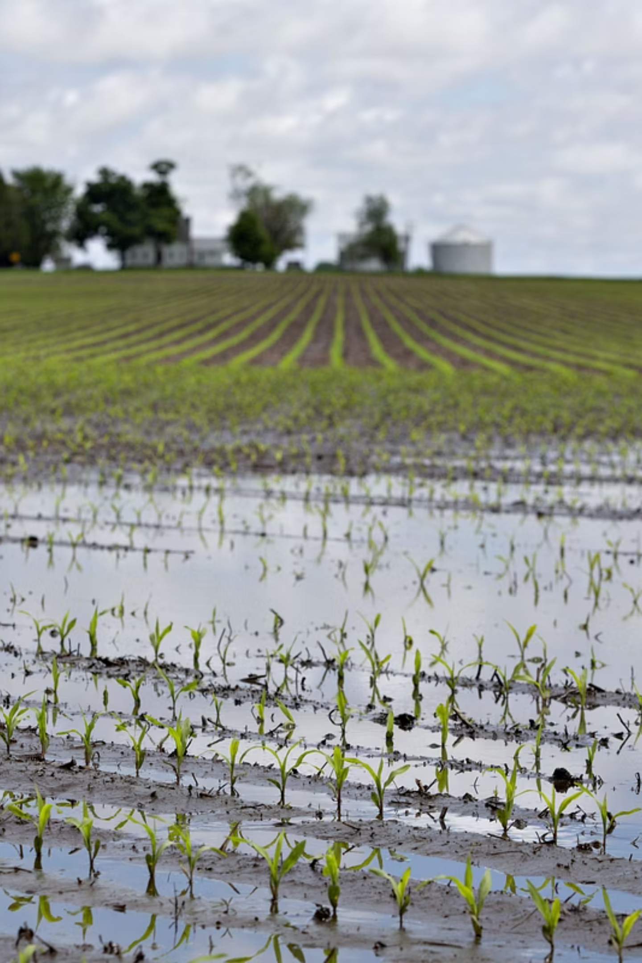
Urban and Agricultural Impacts
Farmers' Struggles
Urban Planners' Concerns
Sudden rains causing soil erosion and disease
Flood-prone zones overwhelming drainage systems
Inaccurate forecasts delaying planting or harvesting
Emergency response delays in community areas
Lack of crop-specific alerts, risking 20-30% yield drops
Need for proactive shady spot identification during storms
Damaging of devices due to the rain exposure.

Slide 5
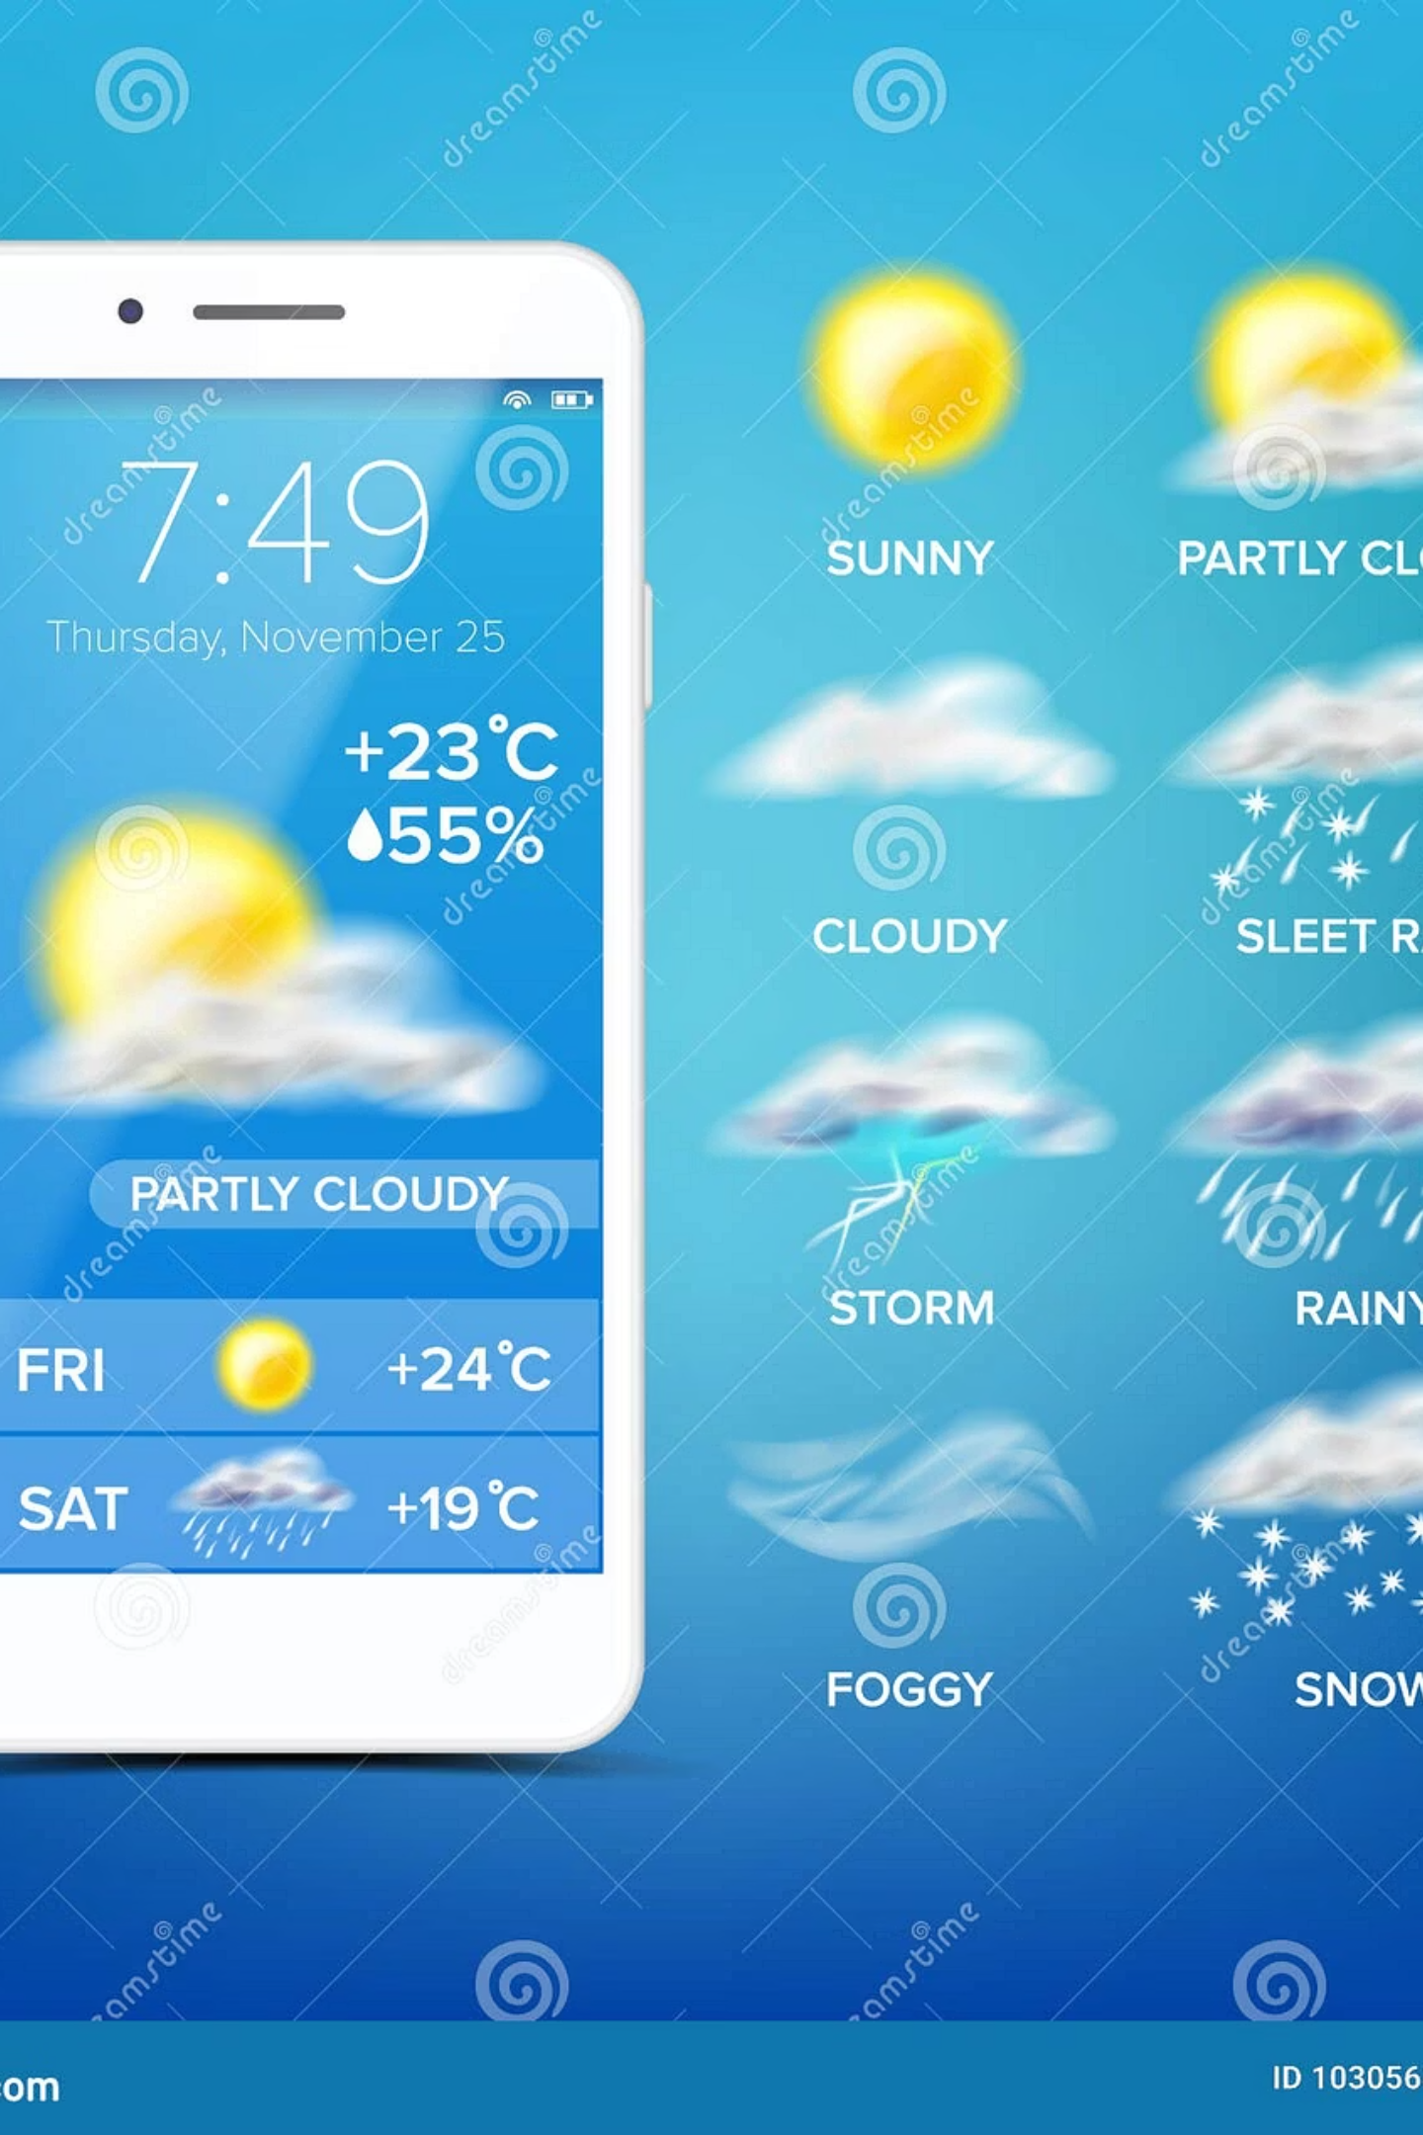


Introducing RainWatch
Our innovative app uses AI-driven weather APIs, satellite data, and machine learning to predict rain probability, location, and intensity with 90% accuracy up to 72 hours ahead. Tailored for US farmers and urban planners, it delivers actionable insights for resilient planning.
Real-Time Rain Detection
Pinpoint exact rain paths and timings using advanced geospatial modeling.
Crop Health Insights
Unique notifications assess if rain will nourish or harm your crops, based on soil type and variety.

Slide 6
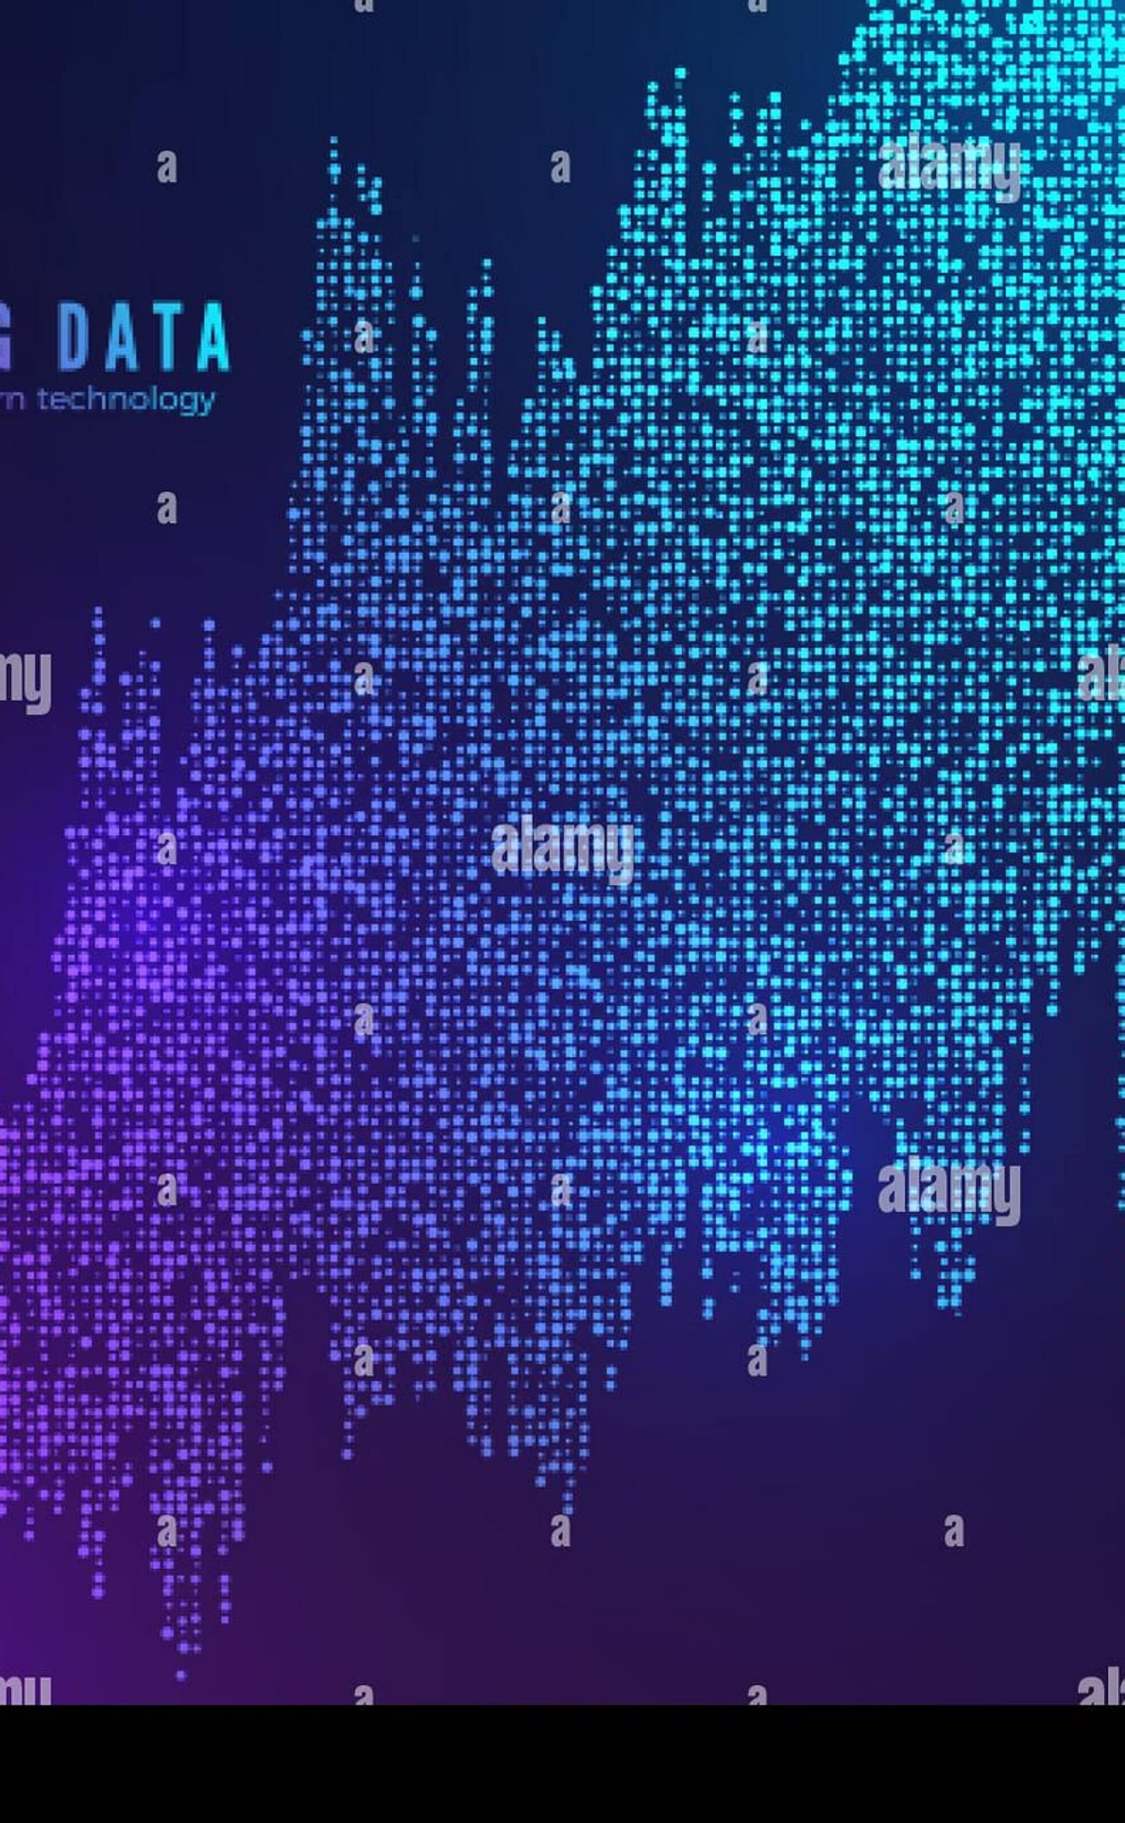

Core Technology Stack
RainWatch integrates weather data from NOAA and ECMWF, processed via Python ML models (e.g., Random Forest for predictions) and deployed on AWS for scalability. User-friendly React Native interface ensures seamless access on mobile devices for on-the-go farmers.
Satellite imagery
NOAA & ECMWF feeds
User notifications
External APIs
RainWatch Data Flow
Alerts via React Native app
Third-party sensor and forecast APIs
Crop analysis
AI prediction engine
Field-level risk & yield insights
Python ML models on AWS

Slide 7

Key Features for Farmers
01
02
03
04
1. Precise Rain Alerts
2. Crop Flourish Predictions
3. Shady Area Scanner
Add-ons
Get hyper-local forecasts: When rain hits, notifications specify duration, intensity, and affected fields.
AI analyzes rain data against your crop profile—e.g., "Ideal hydration for soybeans; expect 15% yield boost"—or warns of risks like fungal outbreaks.
During storms, instant maps highlight safe, shaded spots for livestock or equipment relocation, reducing weather-related damages.
->Calculates
Profit of
Farmers
->Device
Alarm when
Rain falls.

Slide 8

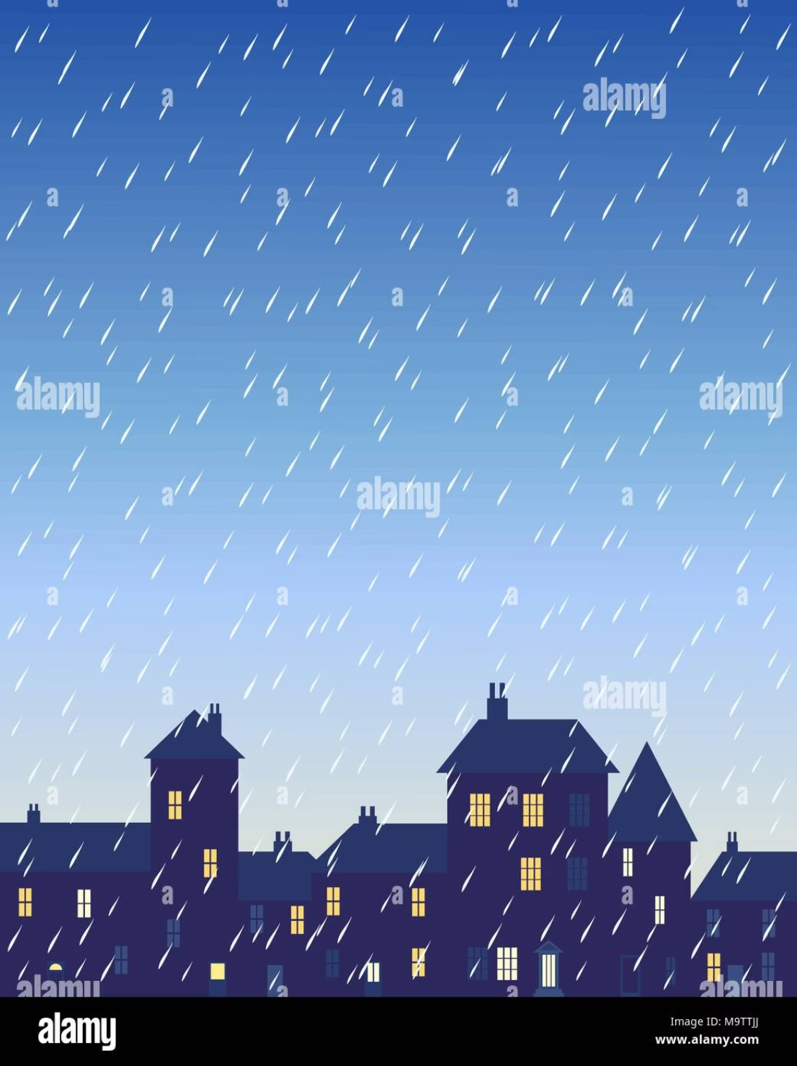

Benefits for Urban Communities
Flood Risk Mitigation
Resource Optimization
Sustainable Planning
Early warnings for low-lying areas help planners evacuate and deploy sandbags proactively.
Identify shady zones for public safety during downpours, enhancing emergency response in parks and streets.
Integrate with city GIS for long-term infrastructure decisions, like green roofs to manage runoff.

Slide 9
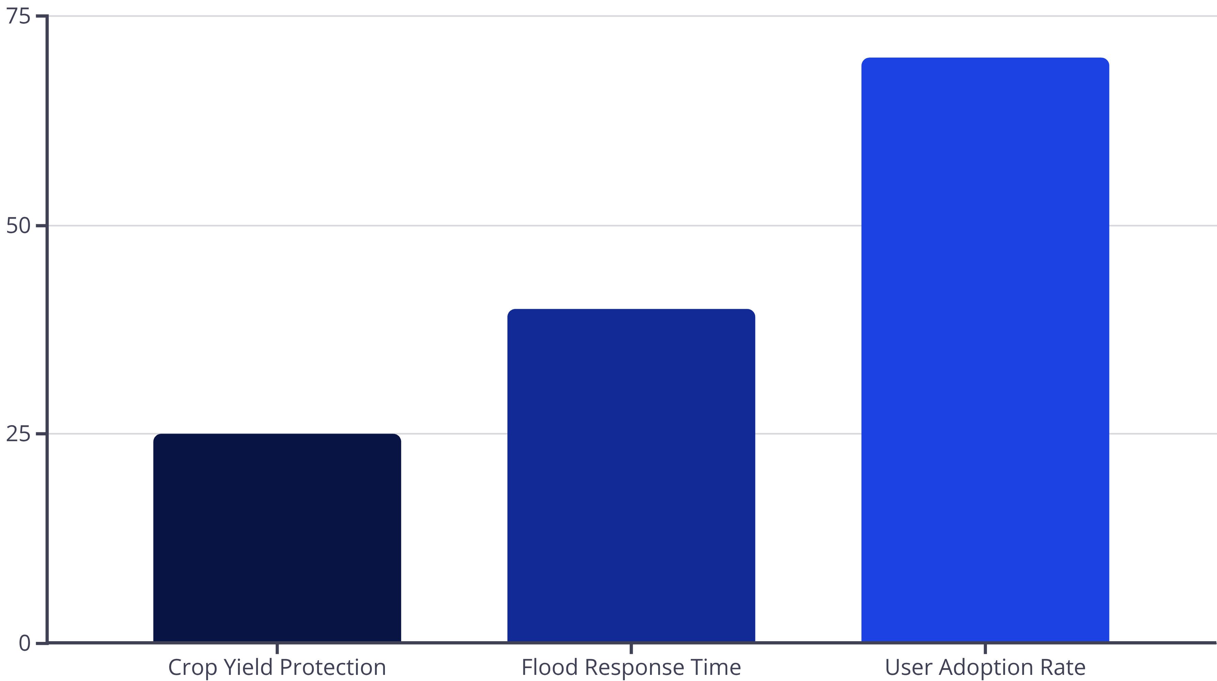
Expected Impact and Evaluation Metrics
These metrics, based on pilot simulations, show RainWatch reducing losses by up to 40% while boosting community resilience—ideal for academic and project evaluations.

Slide 10
Thank You!
Thank you for this opportunity to present Rain Watch.
For more queries or demos, email us at revanthkparna@gmail.com.

